Slide 1


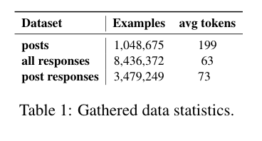
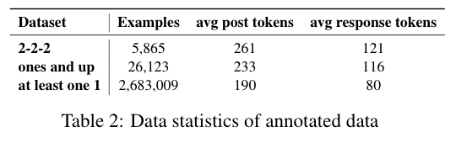

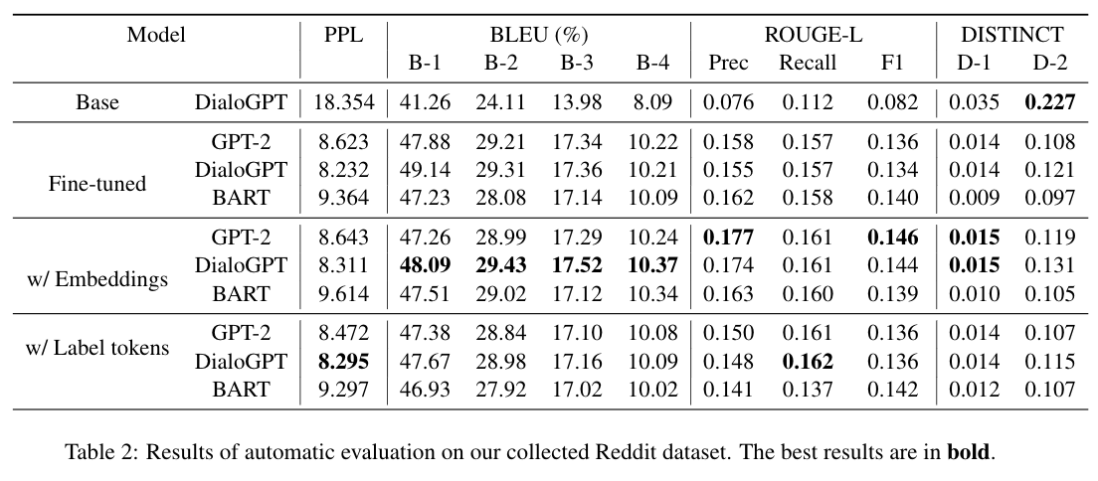

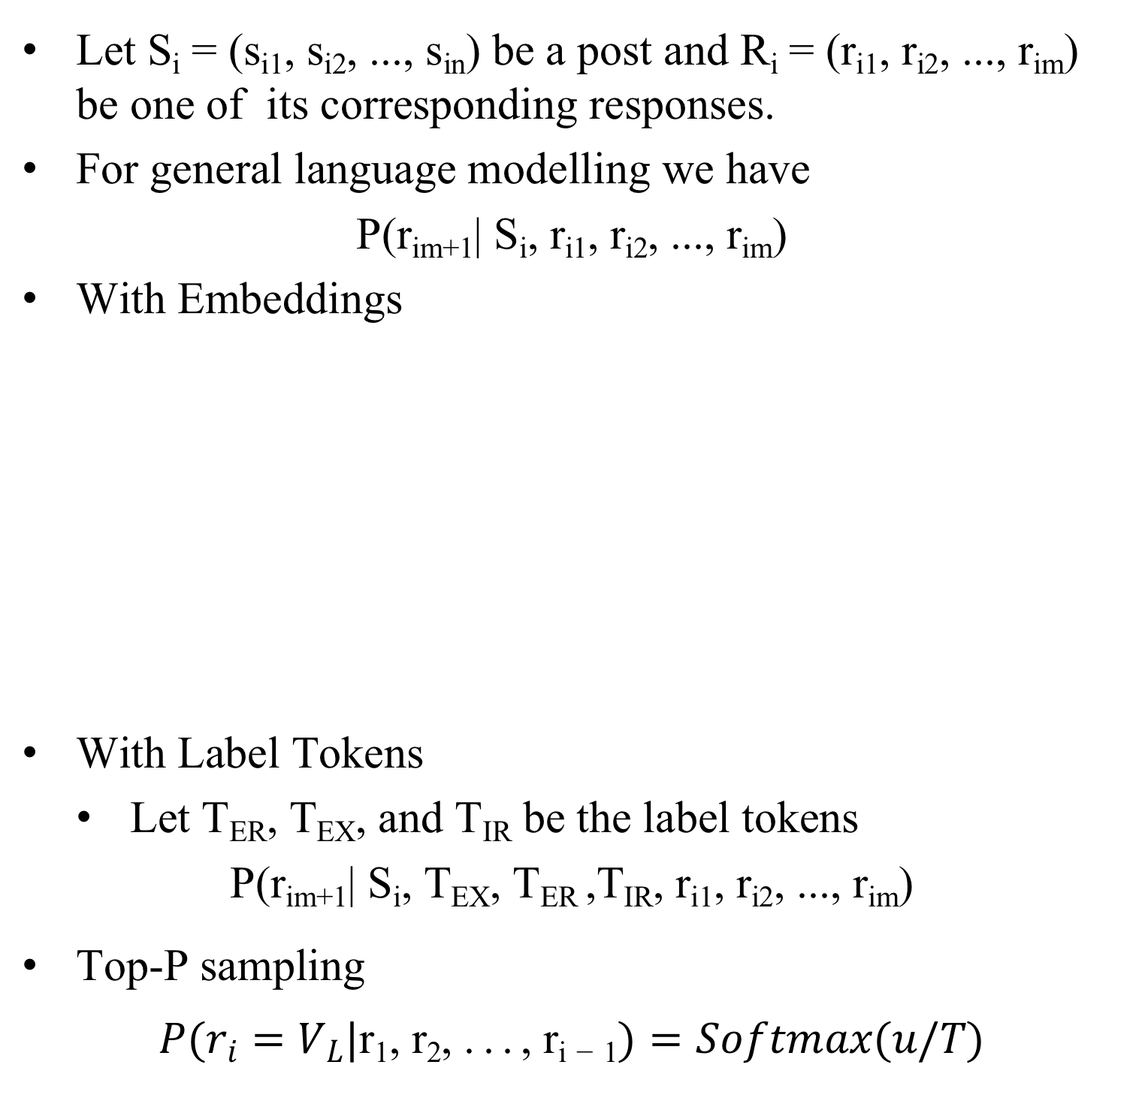
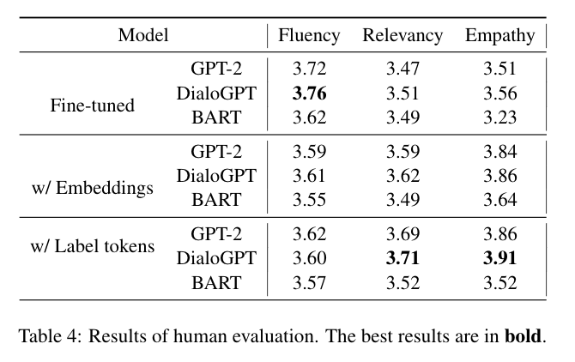
Empathy for Emotional Support
Sahand Sabour
2020280401
Marcin Malinowski
202038003
Introduction
Experiments
Dialogue Systems (DS)
  AI programs that can simulate human conversations.
  Used to help users accomplish tasks (task-oriented).
  Can also engage in normal conversations (open-domain).
Empathy
  A complex multidimensional construct.
  Enables people to understand the situation and the implicit emotions of other people.
Empathetic DS (EDS)
  Aims to demonstrate an understanding of user utterances.
  Responds appropriately in an empathetic manner.
  Builds a trusting relationship with the user.
EPITOME
  Three mechanisms for expressing empathy
    Emotional Reactions (ER)
    Explorations (EX)
    Interpretations (IR)
Dataset
  Collected posts and responses of 55 subreddits from Reddit.
  Filtered and cleaned data based on best practices.
  Annotated the dataset using EPITOME.
Models
  Base: pretrained only.
  Finetuned: trained on the raw data.
  W/ Embeddings: trained with mechanisms as embeddings.
  W/ Label tokens: trained with mechanisms as tokens.
Variations
  GPT-2
  DialoGPT
  BART
Automatic Evaluation
Human Evaluation
I am 18 years old and I was recently rejected by my dream school. My parents say it's ok but this makes me really disappointed in myself.
<ER> I'm sorry to hear that. <IR> I understand how that would make you dissapointed in yourself. <EX> Have you talked to any of your friends about this?
Method
I
am
feeling
really
sad
today
EOS
I'm
really
sorry
to
hear
that
EOS
[s]
ER
2
2
1
2
1
2
2
2
1
1
2
1
2
2
1
0
2
0
2
2
0
0
2
2
EX
0
IR
0
0
0
0
0
0
0
0
0
0
0
0
0
0
Discussions and Conclusions
0
0
0
0
0
0
0
0
0
0
0
0
0
0
Human evaluation results demonstrate that using empathy mechanisms improves the empathy of generated response.
Overall, DialoGPT pairs best with these mechanisms.
Using these mechanisms as label tokens provides the most empathetic results. However, the results obtained from adding embeddings are also considerable.

